Slide 1


GREATER MIAMI & THE BEACHES
HOTEL ASSOCIATION
26th
Annual
Inn Key
AWARDS

Slide 2

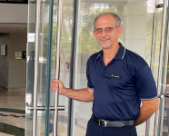

26th
Annual
Inn Key
AWARDS
Bell Person
Achievement Award
Francisco Montero
Pullman Miami Airport

Slide 3
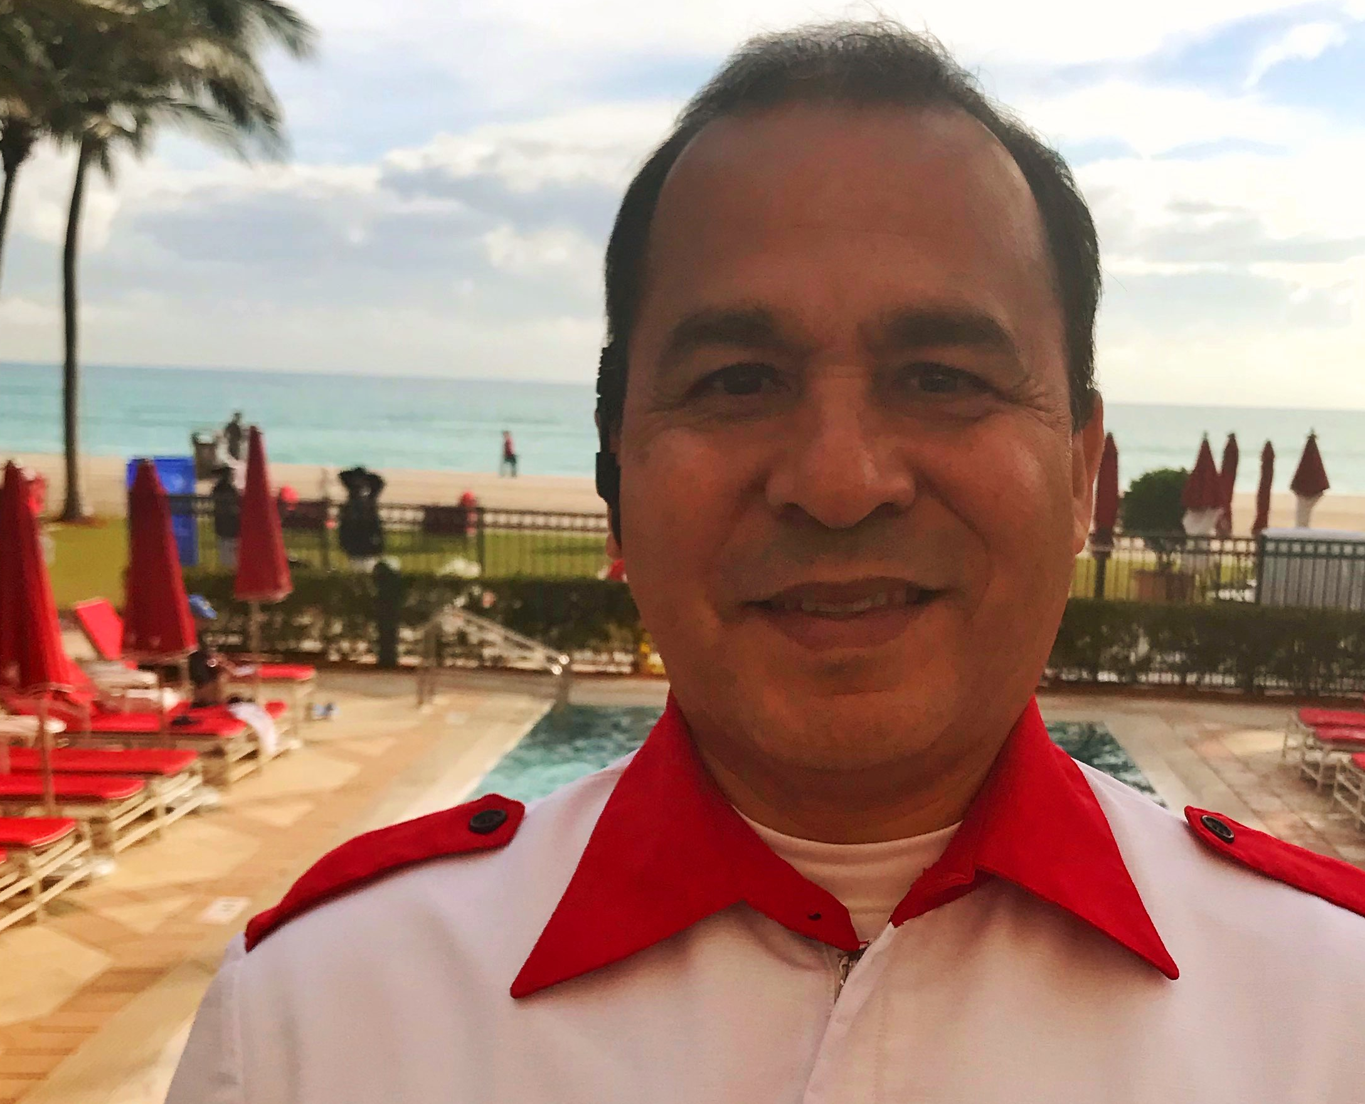

26th
Annual
Inn Key
AWARDS
Bell Person
Achievement Award
Bruno Campana
Acqualina Resort and
Residences on the Beach

Slide 4

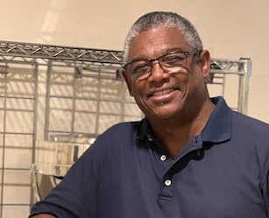
26th
Annual
Inn Key
AWARDS
Food And Beverage
Achievement Award
Wilfredo Ramos
Four Season Miami

Slide 5

26th
Annual
Inn Key
AWARDS
Food And Beverage
Achievement Award
Gineska Rosado
Kimpton Angler’s Hotel

Slide 6
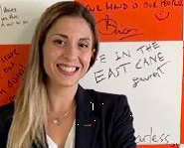
26th
Annual
Inn Key
AWARDS
Front Office
Achievement Award
Martina Grieco
East Miami

Slide 7

26th
Annual
Inn Key
AWARDS
Front Office
Achievement Award
Fritzner Laraque
The Betsy South Beach

Slide 8

26th
Annual
Inn Key
AWARDS
Room Keeper
Achievement Award
Carmen Arce
Hilton Miami Airport
Blue Lagoon

Slide 9
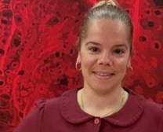
26th
Annual
Inn Key
AWARDS
Room Keeper
Achievement Award
Yadira Estevez
Faena Hotel
Miami Beach

Slide 10
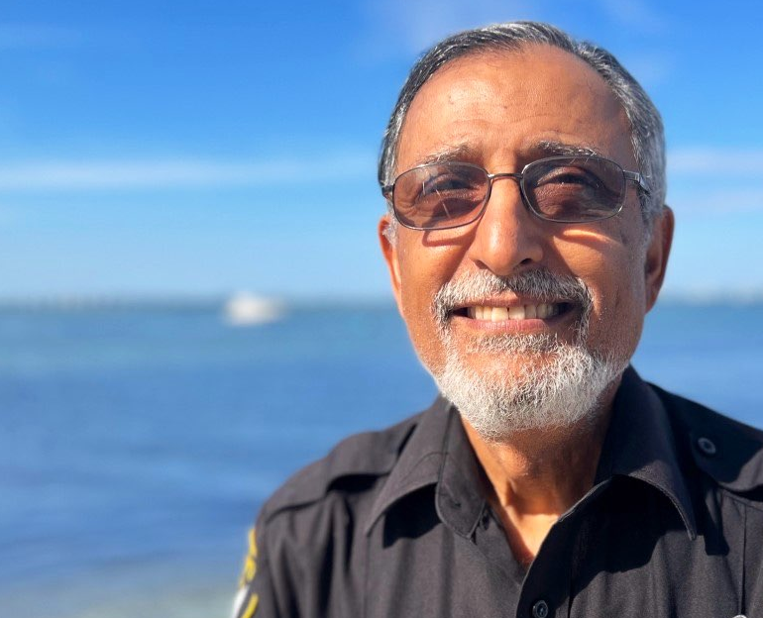
26th
Annual
Inn Key
AWARDS
Security Officer
Achievement Award
Yazdi Patel
Miami Marriot
Biscayne Bay

Slide 11

26th
Annual
Inn Key
AWARDS
Security Officer
Achievement Award
Bryan Acosta
SLS South Beach

Slide 12
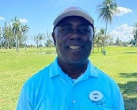
26th
Annual
Inn Key
AWARDS
Recreational
Achievement Award
Joseph Daniel
Miami Lakes
Hotel on Main

Slide 13
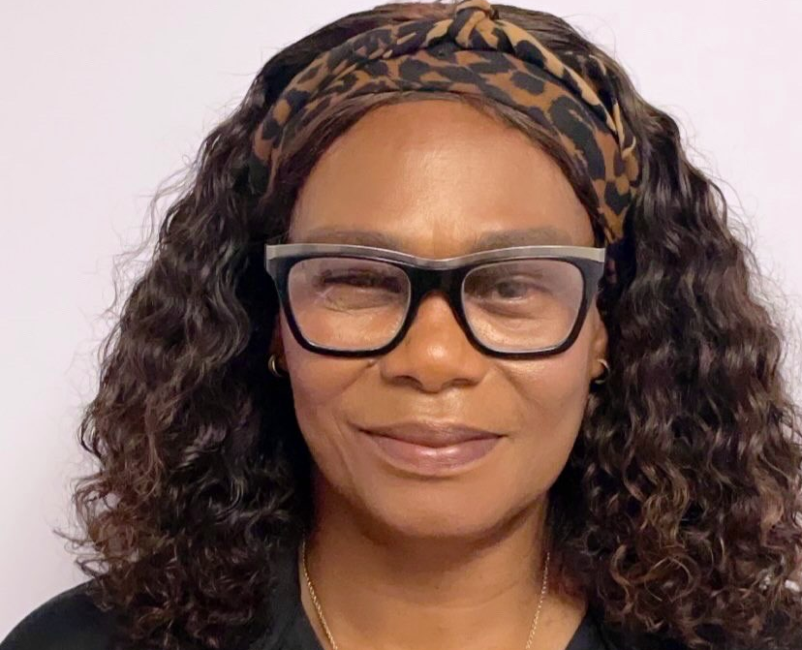
26th
Annual
Inn Key
AWARDS
Recreational
Achievement Award
Jennifer Huggins
Carillon Miami
Wellness Resort

Slide 14
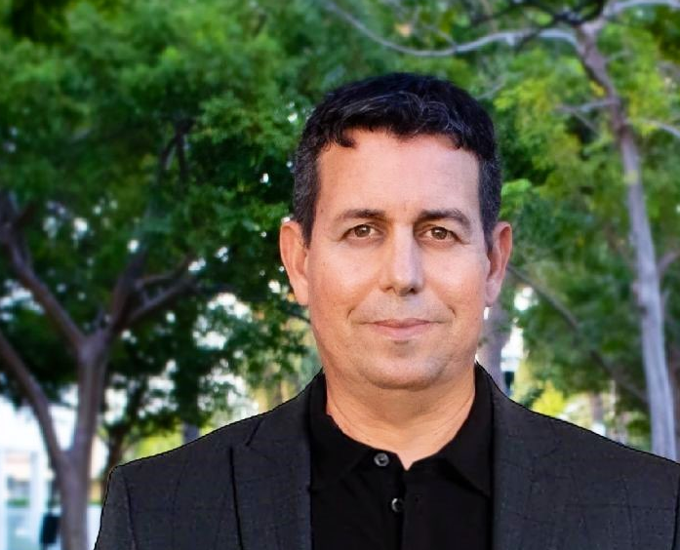
26th
Annual
Inn Key
AWARDS
Engineering
Achievement Award
Nestor Hidalgo
Nobu Eden Roc

Slide 15

26th
Annual
Inn Key
AWARDS
Engineering
Achievement Award
Isidro Gonzalez
The Betsy
South Beach

Slide 16
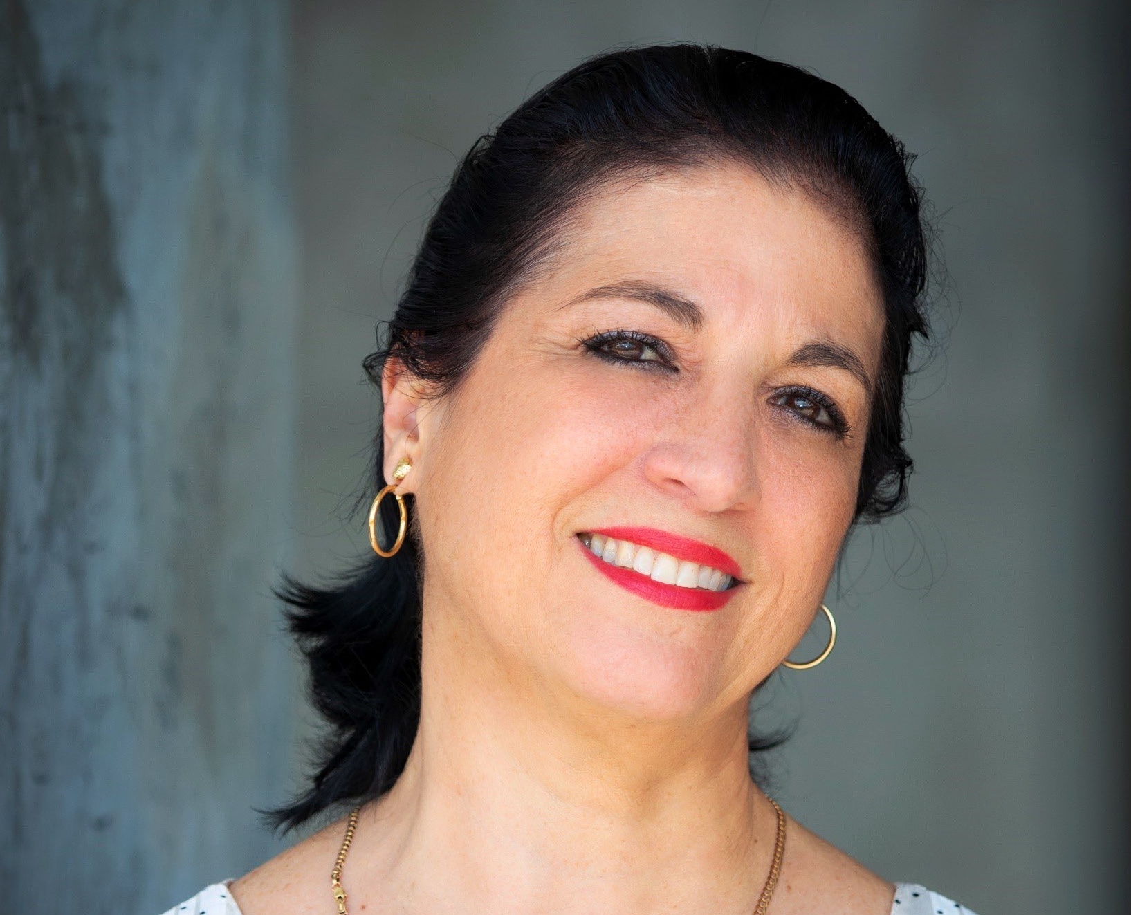
26th
Annual
Inn Key
AWARDS
Culinary/Kitchen
Achievement Award
Evelyn Linares
W South Beach

Slide 17
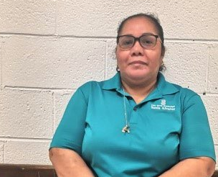
26th
Annual
Inn Key
AWARDS
Culinary/Kitchen
Achievement Award
Sonia Alvarez
The Ritz-Carlton
Coconut Grove, Miami

Slide 18
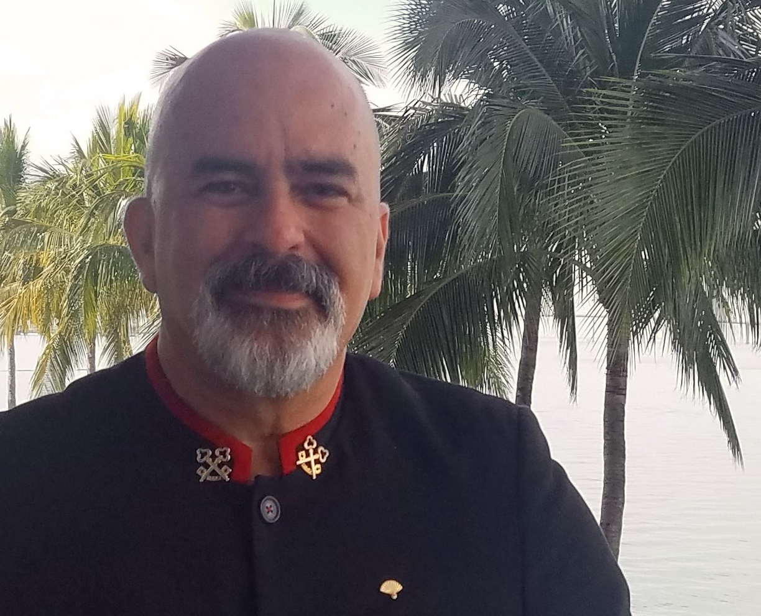
26th
Annual
Inn Key
AWARDS
Concierge
Achievement Award
Carlos Ayala
Mandarin Oriental, Miami

Slide 19
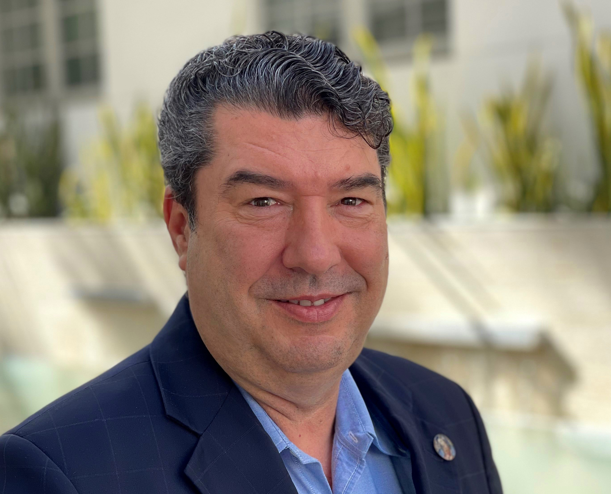
26th
Annual
Inn Key
AWARDS
Concierge
Achievement Award
Juan Carlos Velasco
Dream South Beach

Slide 20
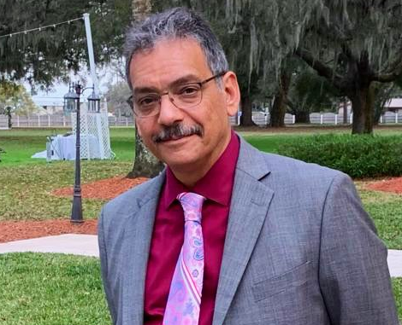
26th
Annual
Inn Key
AWARDS
Essential
Achievement Award
Alexander Pimentel
Intercontinental Miami

Slide 21
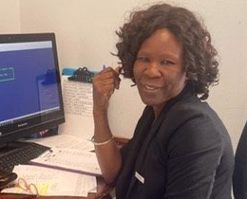
26th
Annual
Inn Key
AWARDS
Essential
Achievement Award
Anastasie MBangue
Courtyard by Marriott
Miami Dadeland

Slide 22
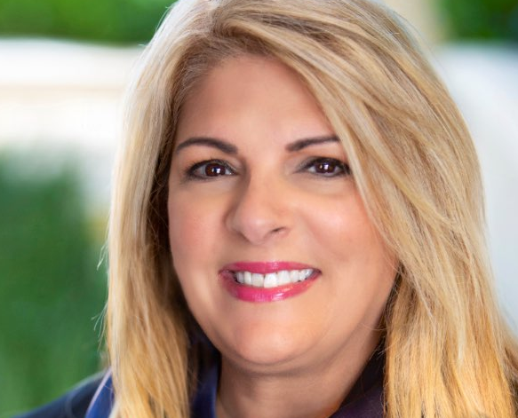
26th
Annual
Inn Key
AWARDS
Administrative
Achievement Award
Rosie Suastegui
The Ritz-Carlton Key Biscayne, Miami

Slide 23

26th
Annual
Inn Key
AWARDS
Administrative
Achievement Award
Amarut Soriano
The Ritz-Carlton Bal Harbour,
Miami

Slide 24

26th
Annual
Inn Key
AWARDS
Banquets
Achievement Award
Robert Frasca
Shelborne South Beach

Slide 25
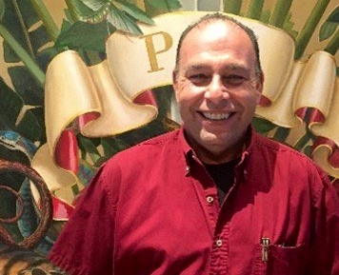
26th
Annual
Inn Key
AWARDS
Banquets
Achievement Award
Annthon Cruz
Faena Hotel Miami Beach

Slide 26
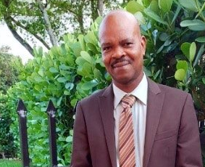
26th
Annual
Inn Key
AWARDS
Employee of the Year
Henriot Lartigue
Lowes Miami Beach Hotel

Slide 27
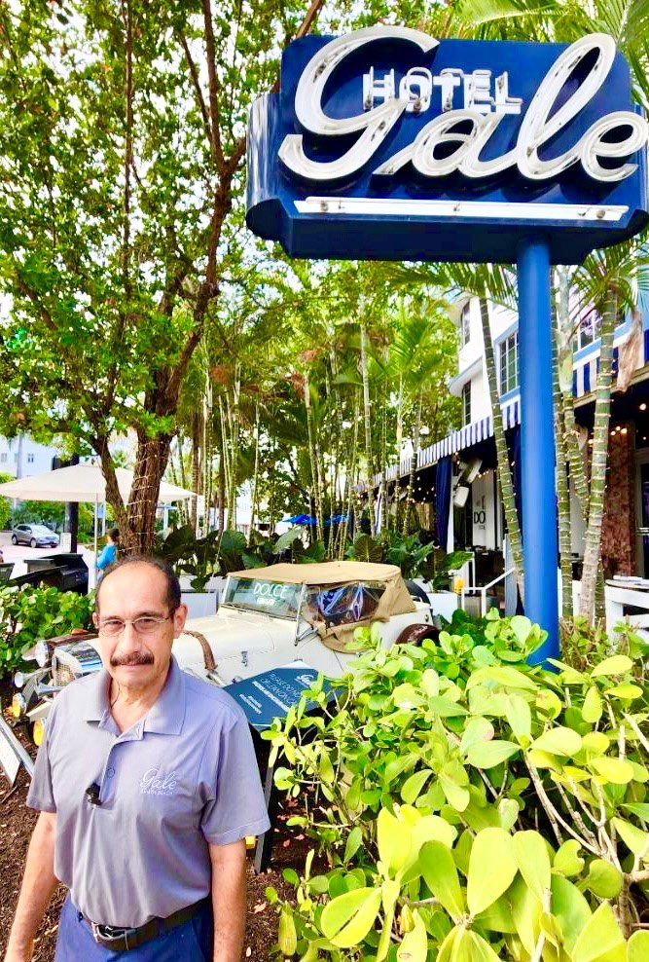

26th
Annual
Inn Key
AWARDS
Employee of the Year
Luis Hernandez
Gale South Beach

Slide 28
GREATER MIAMI & THE BEACHES
HOTEL ASSOCIATION
26th
Annual
Inn Key
AWARDS

